Slide 1
Requirement Engineering
Version 2.0
© Maurizio Morisio, Luca Ardito 2024

Slide 2
Requirement Engineering
Requirement engineering is about defining the product properties before starting development
Process
product

Slide 3
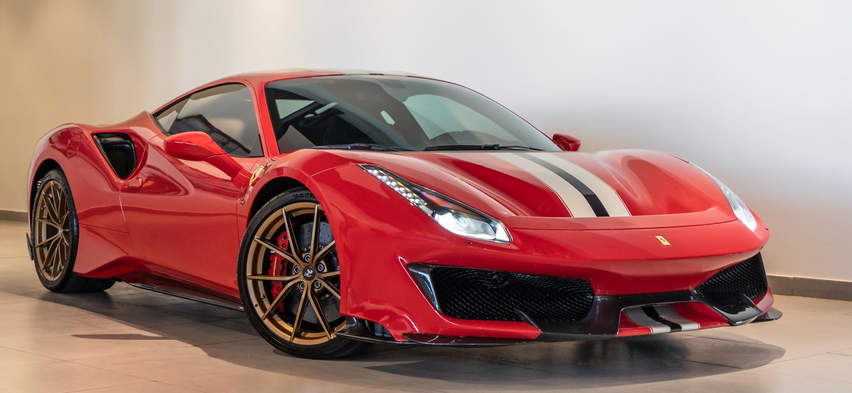
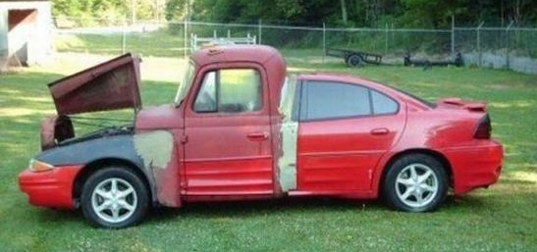
Requirements
Properties

Slide 4
Without RE
Product properties are unclear
Testing is not feasible

Slide 5
Product properties
Functional
what should the program do
Non-functional
Modalities applied to functions offered
Reliability
Usability
Performance
Maintainability
Security
...

Slide 6
Outline
Concepts and definitions
Techniques for formalization
Techniques for elicitation
Techniques for V and V

Slide 7
Main Phases
Development
deployment
Operation
retirement
Maintenance
t

Slide 8
Development
Requirements
definition
Req. inspection
Requirement document
Design
Des. inspection
Design document
Implemen
tation
Code inspection + test
Code
Project management
Configuration management
t

Slide 9
Requirement engineering
elicitation
analyst
Informal
description
Analysis and formalization
stakeholders
Requirement
document
Inspection, reading
Notes:
Objective of this phase is to understand and describe what the system should do
It is a hard task
Implies communication between stakeholders (ex users of the future system) and developers
This is first problem
the users do not know (in general) about IT technilogy and issues
developers do not know about the application domain (ex banking, or health, or ..)
users do not know exactly what they want or are not able to express it clearly – it is a discovery process
done with the developers
Here is how it works
elcitation, talk with user, analyze similar systems, brainstorm
formal and anal- describe system in a doc – we will see structure of doc and techniques to use in it
inspec- to verify that the doc contains what the user really wants
remmber that (laws) problems from this phase are the main caus of proj failures, and defects not
caught here will be much more expensive to correct later
a defect is for instance overlooking an important need, or describing it not as the user wants
The main result of this phase is the req doc
this has two main functions
describe system for user (abstraction – doc is a model of system) so that he recognizes what he wants
describe system for developers, so they know what to develop
req doc has often a contractual value (user company on one side, devel company on other side
req doc is also starting point to estimate cost and time for the development (will see this in PM chapter)
Later we will see one possible structire of req doc, and techniques to use in it

Slide 10
Requirement
Description of product property
Functional – not functional
The final product may, or may not, have properties that match the requirements
Notes:
Start from informal and abstract (at elicitation) end with detailed and precise (hopefully)

Slide 11
Requirements
Properties

Slide 12
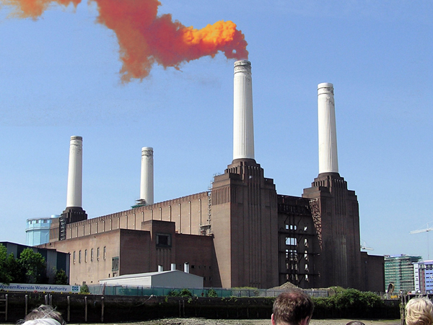
Requirements vs. properties
Requirements
Software product
properties
Requirements are requests, that may or may not become properties of the product

Slide 13
Ex.
Requirement: response time of all functions <0,5 sec
Property: response time of functions between 2secs and 10 secs

Slide 14
Starting point
Usually an informal description by a client or a potential user to the developer

Slide 15
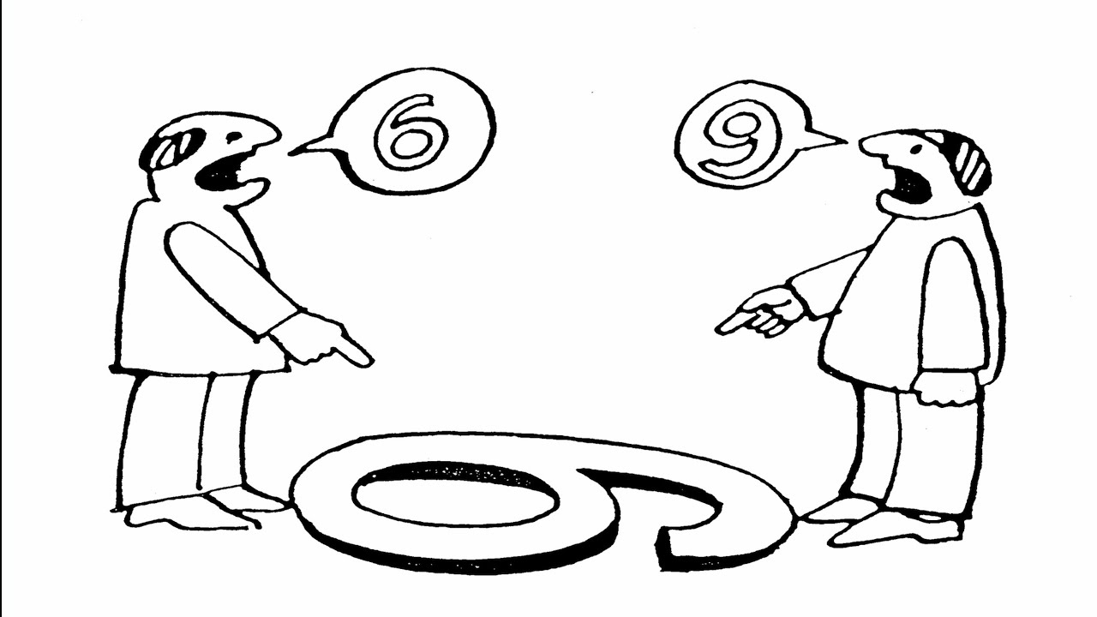
Client
Developer

Slide 16
Requirements - informal
A POS (Point-Of-Sale) system is a computer system typically used to manage the sales in retail stores. It includes hardware components such as a computer, a bar code scanner, a printer and also software to manage the operation of the store.
The most basic function of a POS system is to handle sales.
Notes:
The POS, our running example

Slide 17
Requirements - informal
Problems arise when requirements are not precisely stated.
Ambiguous requirements may be interpreted in different ways by developers and users.
‘manage sales’ and ‘handle sales’ do mean the same thing?
What is a sale? Exchange of items? Payment?

Slide 18
Completeness and consistency
In principle, requirements should be both complete and consistent.
Complete
They should include descriptions of all features required.
Consistent
There should be no conflicts or contradictions in the descriptions of the system features.
In practice, it is quite utopistic to produce a complete and consistent requirements document.

Slide 19
Requirements - defects
Omission/ incompleteness
Incorrect Fact
Inconsistency/contradiction
Ambiguity
Extraneous Information
Overspecification (design)
Redundancy
Notes:
What is exactly a sale? Who can use the POS? What are the functions in handling a sale?

Slide 20
Requirements - defects
Omission/ incompleteness
Log of daily sales should be made and kept for 5 years (omitted)
Incorrect Fact
Sales are subject to 22% VAT (page 3 of document)
No, VAT depends on item, 10% for some, 22% for others
Inconsistency/contradiction
Sales are subject to 21% VAT (page 10 of document)
Ambiguity
‘handle sales’ and ‘manage sales’ are same thing or not?
Extraneous Information
The sales should be stored using a hash table
Redundancy
Sales are subject to 22% VAT (page 3 of document)
Sales are subject to 21% VAT (page 10 of document)
Notes:
What is exactly a sale? Who can use the POS? What are the functions in handling a sale?

Slide 21
Techniques - formalization
Stakeholders
Personas, stories
Context diagram and interfaces
Requirements, F, NF
Scenarios, sequence diagrams
Use cases
Glossary

Slide 22
Stakeholder
Basic idea: ask the client an (informal) description of the product to build
Who exactly is the ‘client’?

Slide 23
Stakeholder
Role person company or system that is directly or indirectly involved in the project and who may affect or get affected by the outcome of the project
User
Uses the application
Can include different user profiles
Buyer/commissioner
Pays for the application
Administrator
Analyst
Expert in requirement engineering and or in the domain
Developer
Notes:
In prev slide discussed about user on one side, devel on other
More correct to talk about stakeholders in the process
They may end up in being few people playing all these roles, but
User is who uses
also in this case it may be abstraction
think of commercial sw with thousands, possibly millions of users
they may use different functions of the system, in different ways – in this case
we talk about user profiles (groups of similar users )
es, powerpoint – simple users makes one presentation with few slides and only text
advanced user makes pres with chapters and audio video effects
etc …
es. Banking system
the fact that there may be many different users (ex account system in bank)
Buyer is the one who decides to order the system and pays for it
in some cases is the user (ex individual who buys powerpoint copy)
in others not (bank, purchase office decides to buy powerpoint, other employees will use it)
user <> buyer is another cause of problems
Administrator has some management role
Roles on developer side
analyst, expert in RE and possibly ina domain
architect, technology expert, programmer, tester

Slide 24
Stakeholders - example
Point Of Sale (POS) in a supermarket
User
Cashier at POS (profile 1)
Supervisor, inspector (profile 2)
Customer at POS (indirectly through cashier)
Administrator
POS application administrator (profile 3)
IT administrator (profile 4)
Manages all applications in the supermarket
Security manager (profile 5)
Responsible for security issues
DB administrator (profile 6)
Manages DBMSs on which applications are based
Buyer
CEO and/or CTO or CIO of supermarket
Notes:
Each user or profile has different point of view on the system and uses different functions
See bank customer at home (likes to control everything.ave all privileges) and security manager (likes to resduce privileges)
This is another source of problem (knowing all points of views and reconciling them in coherent set of requirements)

Slide 25
Stakeholders
Listing the relevant stakeholders is essential to consider relevant points of view (and therefore relevant requirements) for an application

Slide 26
Stories and personas
A technique to informally define what the application should do
Best suited for mass market applications where ‘end user’ has little meaning
AKA profiling / segmentation in marketing, adapted to software products

Slide 27
Profiling / segmentation
Characterize people under a number of dimensions, to better define and sell targeted products / services
Demographic profile
Age
Gender
Ethnicity
Income
Level of education
Religion
Profession/role in a company
Psychographic profile
Personality traits
Hobbies
Life goals
Values
Beliefs
Lifestyles
Geographic profile
Country
Region
City
Postal code

Slide 28
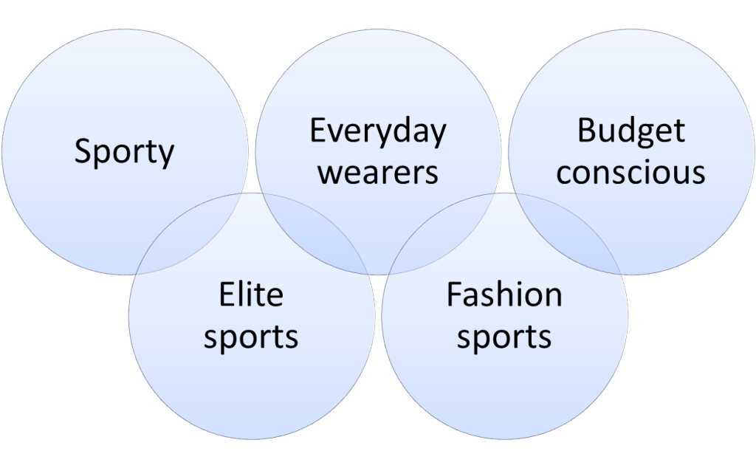
Ex market segments
In garments business, segments could be:

Slide 29
Profiling in e-commerce
Web site behaviour
Number of sessions website
Number of pages visited
Time spent on site
URLs visited
Page types visited
Shopping cart value
Referral source
Inactivity
Web site behaviour - 2
First time visitor
Returning visitor
Returning customer

Slide 30
Use of profiles
First time visitor
Offer x% discount on first order
Returning visitor
Remind of x% discount
Returning customer
Propose products similar to ones previously bought

Slide 31
Context diagram
To understand ‘in’ and ‘out’

Slide 32
Context diagram
Defines what is inside the application to be developed, what is outside
Entity outside = actor
{actor} ⊂ {stakeholder}
Other systems/subsystems/applications
Human users (can specialize in one or more personas)
Defines interfaces between inside and outside
Notes:
Essential for pricing, for understanding, for interfaces

Slide 33
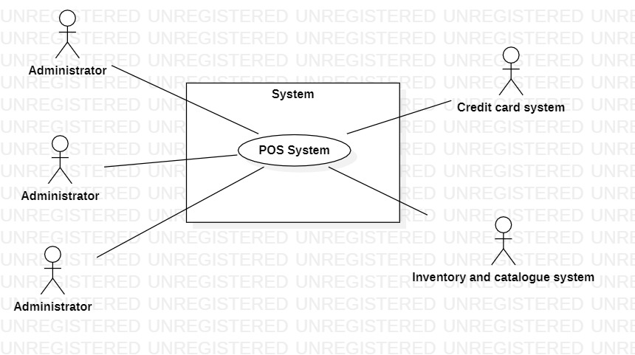
Context diagram
Notes:
Other options were possible (ex catalogue inside, inventroy inside if only one cashier)
Form is UCD of UML

Slide 34
Interfaces
With cashier
Physical level: Screen, keyboard
Logical: GUI (to be described)
With product
Physical level: laser beam (bar code reader)
Logical level: bar code
With credit card system
Physical level: internet connection
Logical: web services (functions to be described, data exchanged, ex http/REST + json)
Notes:
With humans (cashier) → implies a UI or a GUI, to be described in more or lessdetail
(highest detail is sequnce of screenshots)
With objects (good sold) → indirectly through bar code reader
With subsystems (credit card system)

Slide 35
Interfaces – tabular form
Actor | Physical interface | Logical interface
Cashier | Screen, keyboard | Graphical User Interface (to be described, ex slide 46)
Product | Laser beam | ReadBarCode (to be specified, ex slide 44)
Credit card system | Internet connection | API description (ex https://developer.visa.com/docs for ViSA APIs
Administrator | Screen, keyboard | Graphical User Interface + command line interface

Slide 36
Interface specification
Three types of interface may have to be defined
User interfaces, GUIs
Procedural interfaces;
Data exchanged;
Formal notations are an effective technique for interface specification.

Slide 37
Procedural interface description

Slide 38
Data interface (XML)
<food>
<name>Belgian Waffles</name>
<price>$5.95</price>
<description>
two of our famous Belgian Waffles with plenty of real maple syrup
</description>
<calories>650</calories>
</food>
<food>
<name>Strawberry Belgian Waffles</name>
<price>$7.95</price>
<description>
light Belgian waffles covered with strawberries and whipped cream
</description>
<calories>900</calories>
</food>

Slide 39
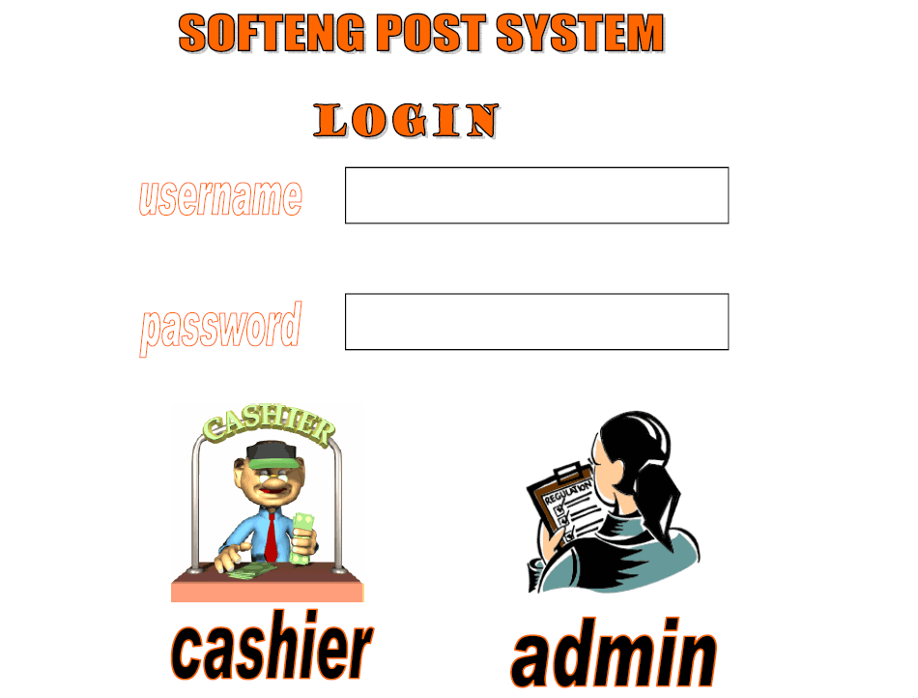
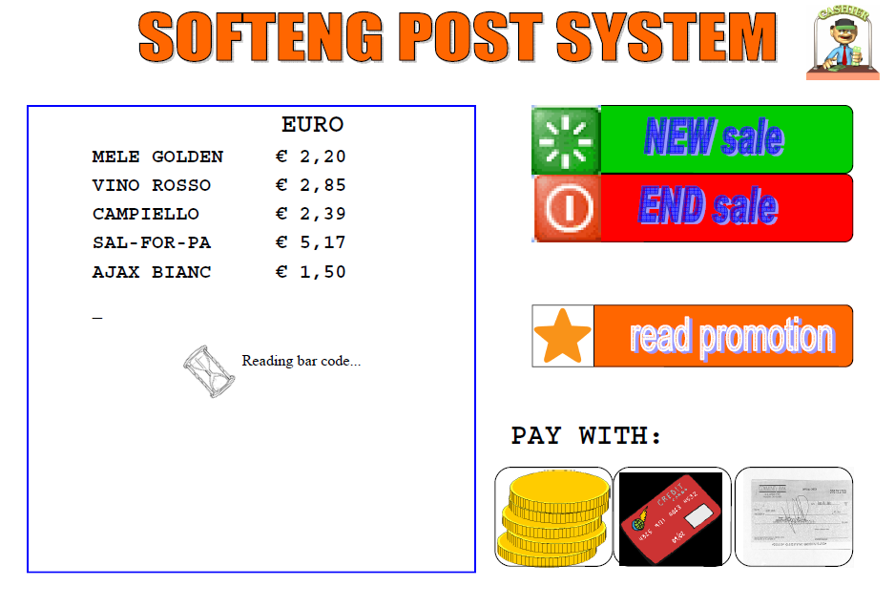
GUI interface
Sketch of interface, typically built with GUI builder

Slide 40
Context diagram and interfaces
Are essential to agree on
What is the scope of the system (and therefore which requirements should offer / which functions should use from outside)
The scope changes radically cost and time to develop
Ex. Inventory and catalogue system could cost 100K to develop if outside (as in current context diagram) that cost should not be included if inside that cost (and time) should be added

Slide 41
Requirement types
Functional
Description of services / behaviors provided by the system
Application vs. domain
Non functional
Constraints on the services
Application vs. domain
(Domain
From the domain (= set of related applications, ex banking, telecom))

Slide 42
Functional requirements
Techniques
Clearly separating and numbering requirement

Slide 43
Functional requirements
Requirement ID | Description
F1 | Handle sale transaction
F2 | Start sale transaction
F3 | End sale transaction
F4 | Log in
F5 | Log out
F6 | Read bar code
Notes:
We are using technique of numbering
no ambiguity on req
trace to implementation and testing

Slide 44
Functional requirements
Techniques
Clearly separating and numbering requirements
Hierarchical numbering

Slide 45
Functional requirements
Requirement ID | Description
F1 | Handle sale transaction
F1.2 | Start sale transaction
F1.3 | End sale transaction
F2 | Authorize and authenticate
F2.1 | Log in
F2.2 | Log out
F2.3 | Define account
Notes:
We are using technique of numbering
no ambiguity on req
trace to implementation and testing

Slide 46
Naming the FR is useful for
Management
FR_x is ready or not?
Is it released or not?
Paid or not?
Testing level
Tested or not?

Slide 47
ISO 9126 / ISO 25010
Defines 6 properties of software systems – 5 non-functional
Functionality
Usability
Efficiency
Reliability
Maintainability
Portability
Security

Slide 48
Usability
Effort needed to learn how to use the product (installation, day-to-day usage)
Satisfaction expressed by the user
Existence of functions needed by the user
Efficiency
For a given function in a given context: response time
For a given function / for a complete product: memory / cpu/ bandwith/ energy used

Slide 49
Correctness
Capability to provide intended functionality in ALL cases
Reliability / availability
Defects visible by end user per time period / Probability of defect over a time period
Percentage of time the product is / is not available to end user

Slide 50
Maintainability
Effort (person hours) needed to add /modify / cancel a software function
Effort to fix a defect
Effort to deploy on a different platform (DB, OS, ..)
Portability
Effort to redeploy application on another platform
Os, database, network, screen

Slide 51
Security
Protection from malicious access
Access only to authorized users
Sharing of data
Safety
Absence of harm to persons
Absence of hazardous situations for persons
Dependability
Safety + security + reliability
GDPR (EU)
CCPA (California)

Slide 52
Non-functional reqs

Slide 53
Non-functional reqs
Product requirements
Requirements which specify that the delivered product must behave in a particular way e.g. execution speed, reliability, etc.
Organisational requirements
Requirements which are a consequence of organisational policies and procedures e.g. process standards used, implementation requirements, etc.
External requirements
Requirements which arise from factors which are external to the system and its development process e.g. interoperability requirements, legislative requirements, etc.

Slide 54
Perception of waiting times
<0.1 sec – not percepted
>1 sec - annoying

Slide 55
Non-functional
Requirement ID | Description
NF1(efficiency) | Function F1.1 less than 1msec
NF2 (efficiency) | Each function less than ½ sec
Domain1 | Currency is Euro – VAT is computed as ..
Notes:
F1.1 retrieve name and price

Slide 56
Non-functional requirements
Non-functional requirements may be more critical than functional requirements. If these are not met, the system is useless.

Slide 57
NF Req must be measurable
Not measurable
The system should be easy to use by experienced controllers and should be organised in such a way that user errors are minimised.
Measurable
Experienced controllers shall be able to use all the system functions after a total of two hours training. After this training, the average number of errors made by experienced users shall not exceed two per day.

Slide 58
Measures for NF reqs

Slide 59
NF requirements such as
«The system should be easy to use»
«The system should be maintainable»
«The system should be portable»
Are not testable, and therefore useless

Slide 60
Requirements interaction
Conflicts between different non-functional requirements are common in complex systems.
Spacecraft system
To minimise weight, the number of separate chips in the system should be minimised.
To minimise power consumption, lower power chips should be used.
However, using low power chips may mean that more chips have to be used. Which is the most critical requirement?

Slide 61
Requirements interaction
Efficiency vs security
Efficiency → minimize number of software components and calls between them
Security → add components (and layers and calls)

Slide 62
Requirements interaction
In the end key stakeholders must decide the ranking of NF requirements
More important security or efficiency?
This decision is a business decision (not a technical one) and should NOT be taken by developers

Slide 63
Domain requirements
Derived from the application domain and describe system characteristics and features that reflect the domain.
Domain requirements can be new functional requirements, constraints on existing requirements or define specific computations.
If domain requirements are not satisfied, the system may be unworkable.

Slide 64
Train protection system
The deceleration of the train shall be computed as:
D_{train} = D_{control} + D_{gradient}
where D_{gradient} is 9.81ms² * compensated gradient/alpha and where the values of 9.81ms² /alpha are known for different types of train.

Slide 65
Domain req. problems
Understandability
Requirements are expressed in the language of the application domain;
This is often not understood by software engineers developing the system.
Implicitness
Domain specialists understand the area so well that they do not think of making the domain requirements explicit.

Slide 66
Glossary
Sale = commercial transaction between customer and retailer, where customer buys a number of products from the retailer
Product = ..
Notes:
So, what is a sale again?
Same word can mean different things for different people, and this can be killer
Glossary (and class diagram) aim at defining without ambiguity key terms

Slide 67
Class diagram
See UML slides
Can be used
To refine glossary
To describe application model
To describe system design

Slide 68
Glossary with Class diagram

Slide 69
What classes in UML for glossary?
For physical objects
Ex Pilot, Aircraft, Airline, Airport
For legal / organizational entities
Company, airline, university, department
Descriptors
Ex Aircraft type, Pilot Qualification
Time (events)
Departure of aircraft
Commercial transaction
Event + exchange of money / good / service
Time (intervals)
Flight, Internship

Slide 70
Scenario and Use Cases

Slide 71
Scenario
Sequence of steps (events) that describe a typical interaction with the system
Sequence: time is key part of this model
Time is NOT part of Functional requirements, Glossary, Context diagram, Use cases

Slide 72
Scenario sale1
Step | Description
1 | Start sales transaction
2 | Read bar code X
3 | Retrieve name and price given barcode X
 | Repeat 2 and 3 for all products
4 | Compute total T
5 | Manage payment cash amount T
6 | Deduce stock amount of product
7 | Print receipt
8 | Close transaction

Slide 73
Sale1
Precondition
Cashier is authenticated

Slide 74
Scenario login
Step | Description
1 | Cashier starts application
2 | Application asks account name, pwd
3 | Cashiers enters account name, pwd
4
5
6
7
8

Slide 75
Scenario login
Precondition: cashier is not authorized
Post condition: cashier is authorized and authenticated

Slide 76
Other scenarios
(payment cash)
Payment with credit card
Payment with loyalty card
Payment does not succeed, abort sale
Customer refuses an item

Slide 77
Scenario / pre post conditions
Precondition
Condition to be satisfied before starting the scenario
Ex: bar code X is valid
Ex: bar code X corresponds to a product available in the shop
Postcondition
Condition satisfied at end of the scenario
Ex: amount in cash after transaction = amount in cash before transaction + T

Slide 78
Use case
Set of scenarios with common user goal
Ex: use case: Handle sales
Scenario1: sell 2 products
Scenario2: sell 3 products
Scenario3: sell n products, abort sale because customer has no money
Scenario 4: sell n products, customer changes one of the products

Slide 79
Ex other use cases
Handle coupons
Handle users

Slide 80
Use case diagram

Slide 81
Use case
Captures a contract between the actors of a system about its behavior.
Describes the system’s behavior under various conditions as it responds to a request
from the primary actor.
The primary actor initiates an interaction with the system to accomplish some goal.
The system responds, protecting the interests of all the stakeholders.

Slide 82
Use case
A scenario is a sequence of steps describing an interaction between a user and a system
A use case is a set of scenarios tied together by a common user goal.
Use case similar to Class (Model)
Scenario similar to instance of class

Slide 83
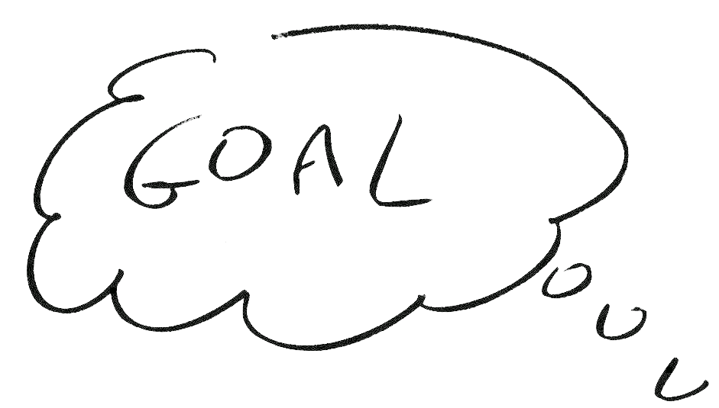
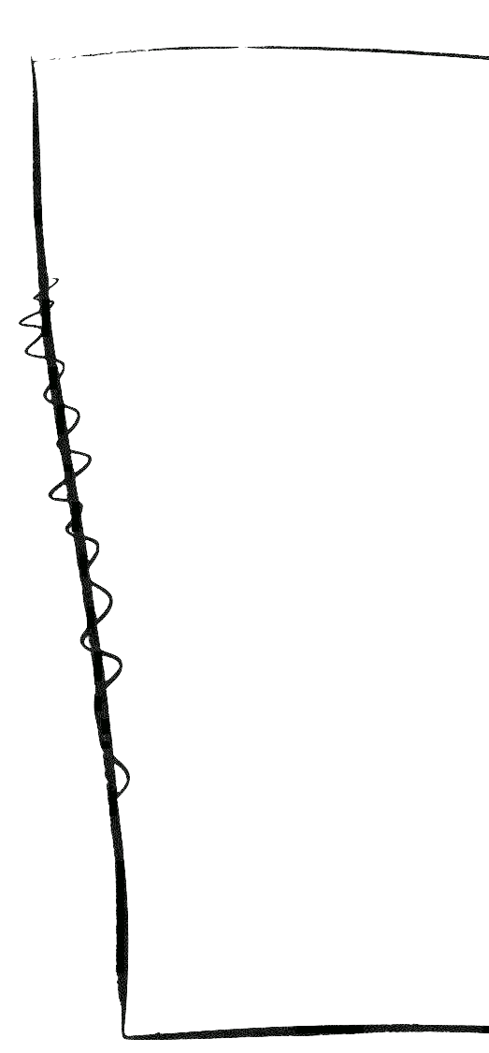
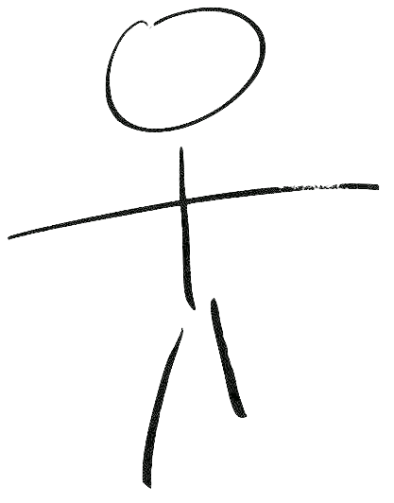
Key elements
System
User (Actor)
Interactions

Slide 84
Key Elements
The actor involved
type of user that interacts with the system
The system being used
treated as a black-box
The functional goal that the actor achieves using the system
the reason for using the system

Slide 85
Actors, stakeholders
Actor <= stakeholders
External to system
Actors can be
Humans
Other machines / systems
Actors can be
Primary: start the interaction with the system
Secondary: are passive wrt the system

Slide 86
Goals
The use case cares only about the relationship of the actor to the system
The goal must be of value to the (primary) actor:
“Enter PIN code” is not
“Withdraw cash” is

Slide 87
Goal
As a <actor type>
I want <to do something>
So that <some value is created>
Notes:
As a bank customer
I want to perform a withdrawal
So that I get some cash

Slide 88
Goal
bank customer
As a <actor type>
I want <to do something>
So that <some value is created>
to perform a withdrawal
I get some cash for me
Notes:
“As a member of the Madonna Fan Club,
I want to order concert tickets by phone before they go on sale to the general public,
So that I can get great seats and feel special.”
Excerpt From: Chris Sims. “The Elements of Scrum.” iBooks.

Slide 89
Elements of a Use Case
Someone (user) or something (external system, hardware) that
Exchanges information with the system
Supplies input to the system or receives output from the system
A functional unit (functionality) part of the system
Actor
Use Case

Slide 90
Relationships
1
*
Association models:
Which actors participate in a use case
Where execution starts
Adornments (e.g. multiplicity, direction) allowed
Actor1 participates in Use CaseA and is the trigger of the use case
Actor2 participates in UseCaseB and UseCaseB is the trigger
Use Case A
Actor
Use Case A
Actor
Use Case B
Actor
Include
Models that functionality A is used in the context of functionality B (one is a phase of the other)
<<include>>
Use Case A
Use Case B

Slide 91
Relationships: generalization
Generalization
Defines functionality B as a specialization of functionality A (e.g. a special case)
Use Case A
Use Case B
1
*
Generalization
A generalization from an actor B to an actor A indicates that an instance of B can communicate with the same kinds of use-case instances as an instance of A
Place Order
SalesPerson
1
*
Establish Credit
Supervisor

Slide 92
Relationships: extension
Extension
An extend relationship from use case B to use case A indicates that an instance of use case A may be augmented by the behavior specified by B.
The behavior is inserted at the location defined by the extension point (name: where) in A, which is referenced by the extend relationship.
Use Case C
<<include>>
<<extend>>
Extension points
bigError : before C
Use Case B
Use Case A

Slide 93
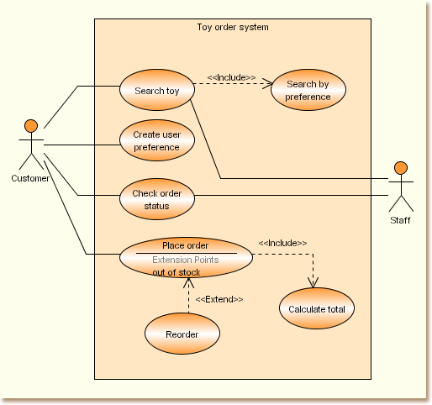
Use case - Example

Slide 94
Use case
A scenario is a sequence of steps describing an interaction between a user and a system
A use case is a set of scenarios tied together by a common user goal.

Slide 95
Use cases vs requirements
Requirement (functional)
Use case or scenario in the use case or step in scenario
Mapping is not 1:1
The requirement purpose is to support traceability and tends to be finer-grained than the use case
The use case purpose is to understand how the system works

Slide 96
Use cases vs requirements
High level requirement (ex F1, F2)
Low level requirement (ex F1.1 F1.2)
Use case that includes other use cases
Use case <included> by other use case

Slide 97
Example: student management
students select courses
professors update the list of available courses
professors plan exams for each course
professors can access the list of students enrolled in a course
professors perform exams and then record issues of exam for students (pass/no pass, grade)
all users should be authenticated

Slide 98
Example
Administrative Office
Select Course
Request List of Students
<<include>>
<<include>>
Authenticate User
<<include>>
<<include>>
Professor
Student
Request List of Courses
Insert Course

Slide 99
Example
<<include>>
Book Hotel
Check availability
<<include>>
Customer
Acquire Customer data
<<include>>
Acquire Credit Card data
Book Hotel with Credit Card

Slide 100
Use Case Diagram and Class Diagram
They must be consistent.
Use case diagram
actor
use case
interaction
Class diagram
may become a class
must become one operation on a class - may originate several operations on several classes (see sequence diag)
not represented (see dynamic diagrams)

Slide 101
Use case briefs
Summary consisting of 2-6 sentences
What is going on
Most significant activities

Slide 102
UC
Nominal scenario
Payment via credit card
All correct (credit card number, amount, exp date...)
Exception scenarios
Credit card number incorrect
Exp date incorrect
Amount too high
...

Slide 103
System design
Subsystems (software and not software) that compose the system

Slide 104
System design and context diagram
System design lists all subsystems (or components) that are INSIDE the context diagram
System design must be consistent with context diagram

Slide 105
Example
Bar code reader is IN

Slide 106
Example
Bar code reader is OUT

Slide 107
System design vs deployment d
Class that represents a computing component → Node
Class that represents a software component → Artifact
NODE
ARTIFACT

Slide 108
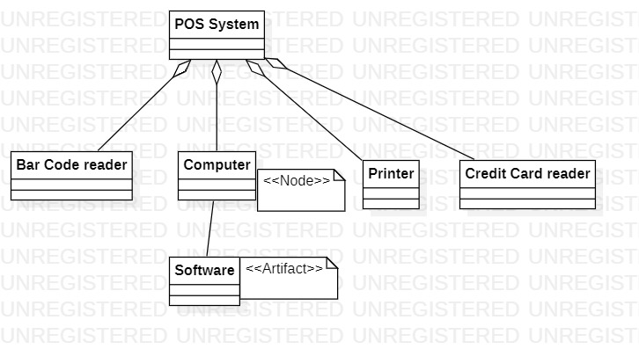
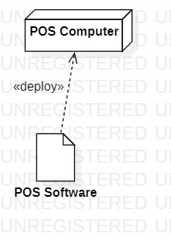
System design vs deployment

Slide 109
The requirement document
Result of RE
Formalizes the requirements

Slide 110
Requirement doc structure
1 Overall description
2 Stakeholders
3 Context diagram and interfaces
4 Requirements
Functional
Non functional
Domain
5 Use case diagram
6 Scenarios
7 Glossary
8 System design
Notes:
This example tries to show key parts of the req doc – but it is not ‘the’ req doc, see others
Google ‘software requirements template’ and you will find many
The req doc is the rsult of the process – and we’ll see a req doc ‘set and ready ’
this is not real, the process to produce it is painful, long and not linear (work on many parts in parallel, in any sequence)
See POS system doc for complete example
Many items shown here come from that example
See UML distilled for UML

Slide 111
Req document and techniques
The requirements document provides a structure
Within the structure different techniques can be used
The structure may change, order of parts is less important than precise description of parts

Slide 112
Req document vs. techniques
Overall description
Stakeholders
Context diagram
Interfaces
Requirements
Use cases
Scenarios
Glossary
System design
Text
Text
UML UCD
Text, PDL, XML, screenshots
Type, numbering
UML UCD, UC briefs
Tables, text
Text, UML CD
UML CD

Slide 113
RE - techniques

Slide 114
Other requirement structures
http://readyset.tigris.org
IEEE Std 830 1994
Introduction.
General description.
Specific requirements.
Appendices.
Index.

Slide 115
Techniques - elicitation
Focus group
Interviews
Questionnaire
Ethnography

Slide 116
Focus group
Moderator + group of homogeneous people
The moderator starts and monitors discussion on defined topics
Open or script-guided
Long
Group interaction

Slide 117
Questionnaire
Written questions with open /close answers
Statistical analysis, more data points possible

Slide 118
Interview
Deep discussion, one to one
Open or guided by script / questions
Interviewer reports log
Long, detailed

Slide 119
Ethnographics
Researcher is ‘hidden’ in an environment and observes facts and behaviour of user / population
Expensive, long
Risk of being invasive

Slide 120
Styles in RD
Operational vs descriptive
Formal, semiformal, informal
Software vs System and software

Slide 121
Techniques – V and V
Inspections/reading
Prototyping
Iterations
(Model checking on formal languages)

Slide 122
Inspections
See V&V chapter

Slide 123
Prototyping
Develop a running prototype
Capable of implementing the key functional requirements
Loose on non-functional requirements
Fast (must be ready in a fraction of the time needed to develop the complete application)
Possibly using a dedicated technology, different from the one used for the final system (ex prototype in matlab, application in C)

Slide 124
Iterations
Develop a first running version of product, with most important requirements
60 requirements -> 6 months
10 requirements -> 1 month
To be evolved in final system
See process chapter

Slide 125
MVP
Minimum viable product
Develop essential functionality
Try it with end users

Slide 126
Support Tools for RE
RequisitePro, Doors, Serena RM
Word, Excel
UML tools
Powerpoint, Visio, specialized tools (StarUML, Astah, PlantUml, ..)

Slide 127
Summary
Goal of requirement engineering is describing what the system should do in a requirement document
Many stakeholders are involved in the process
Techniques to make the document more precise are
Context diagram and interfaces
Identifying requirements and classifying them (functional, non functional, domain)
Scenarios
Use cases

Slide 128
Summary
Requirements engineering is a key phase
Most defects come from this phase, and they are the most disruptive and most costly to fix
Verification and validation is essential
Inspection
prototype

Slide 129
Appendix

Slide 130
Domain
Collection of related functionality
or
collection of applications with similar functionality)
Ex. banking, that includes subdomains account management, portfolio managemenmt, etc
Ex. telecommunication, that includes subdomains switching, protocols, telephony, switching

Slide 131
Application
Or system
Software system supporting a specific set of functions. Belongs to one or more domains

Slide 132
Other techniques for RE

Slide 133
Structured presentation

Slide 134
Form-based specifications
Definition of the function or entity.
Description of inputs and where they come from.
Description of outputs and where they go to.
Indication of other entities is required.
Pre and post-conditions (if appropriate).
The side effects (if any) of the function.

Slide 135
Form-based

Slide 136
Tabular specification
Used to supplement natural language.
Particularly useful when you have to define a number of possible alternative courses of action.

Slide 137
Tabular specification

Slide 138
The POS system – requirement document

Slide 139
Requirements document
1 Overall description
2 Stakeholders
3 Context diagram and interfaces
4 Requirements
Functional
Non functional
Domain
5 Use case diagram
6 Scenarios
7 Glossary
8 System design
Notes:
This example tries to show key parts of the req doc – but it is not ‘the’ req doc, see others
Google ‘software requirements template’ and you will find many
The req doc is the rsult of the process – and we’ll see a req doc ‘set and ready ’
this is not real, the process to produce it is painful, long and not linear (work on many parts in parallel, in any sequence)
See POS system doc for complete example
Many items shown here come from that example
See UML distilled for UML

Slide 140
1 Overall description
A POS (Point-Of-Sale) system is a computer system typically used to manage the sales in retail stores. It includes hardware components such as a computer, a bar code scanner, a printer and also software to manage the operation of the store.
The most basic function of a POS system is to handle sales
…

Slide 141
2 Stakeholders
User
Cashier at POS (profile 1)
Supervisor, inspector (profile 2)
Customer at POS (indirectly through cashier)
Administrator
POS application administrator (profile 3)
IT administrator (profile 4)
Manages all applications in the supermarket
Security manager (profile 5)
Responsible for security issues
DB administrator (profile 6)
Manages DBMSs on which applications are based
Buyer
CEO and/or CTO of supermarket

Slide 142
3.1 Context diagram
Notes:
Other options were possible (ex catalogue inside, inventroy inside if only one cashier)
Form is UCD of UML

Slide 143
3.2 GUI interface
Sketch of interface, typically built with GUI builder

Slide 144
4.1 Functional requirements
Requirement ID | Description
F1 | Start sale transaction
F2 | End sale transaction
F3 | Log in
F4 | Log out
F5 | Read bar code

Slide 145
4.2 Non-functional requirements
Requirement ID | Description
NF1(efficiency) | Function F1 less than 1msec
NF2 (efficiency) | Each function less than ½ sec
Domain1 | Currency is Euro – VAT is computed as ..

Slide 146
5 UCD

Slide 147
6 Scenarios
Step | Description
1 | Start sales transaction
2 | Read bar code
3 | Retrieve name and price given barcode
 | Repeat 2 and 3 for all products
4 | Compute total
5 | Manage payment cash
6 | Deduce stock amount of product
7 | Print receipt
8 | End sales transaction

Slide 148
7 Glossary

Slide 149
8 System design

